Slide 1
Project Portfolio
Lena Choe (lenachoe2024@u.northwestern.edu)

Slide 2
Contents
Predictive Models using Machine Learning
Real Estate Rent Prediction
TBM (tunnel boring machine) Utility Prediction
Kpop Lyric Text Analysis
US News University Ranking Survey Data Mining
BASIC256 Programming Tutorial

Slide 3
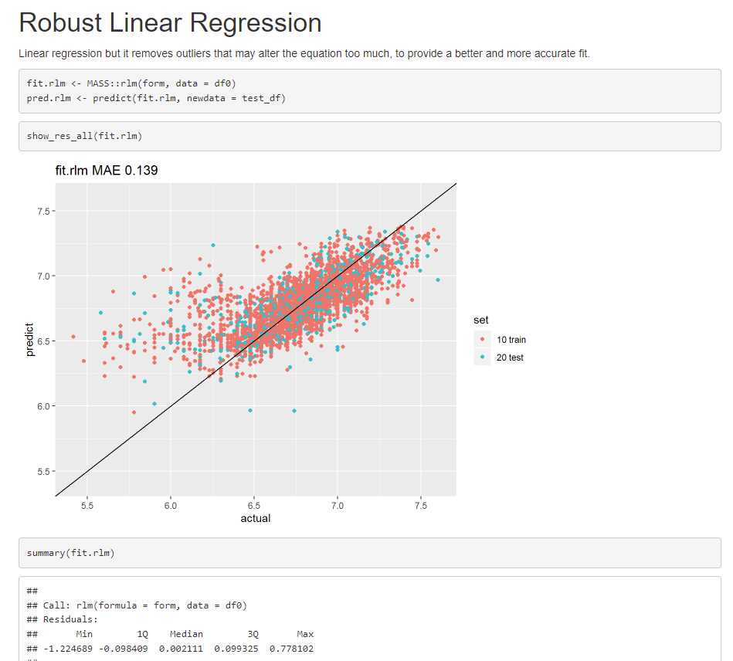
Prediction – Real Estate Price
Built a model predicting monthly rent for commercial offices. Utilized location, office space, age of the building, nearby subway stations, and other amenities such as free parking.
Applied various modeling techniques such as linear regression, decision tree, and neural networks, and choose the best model by comparing performances of the models.
Created a Shiny app summarizing results from various models and comparing performances.
Result of Robust Linear Regression, created from a RMarkdown document.
Green: train samples, Red: test samples

Slide 4
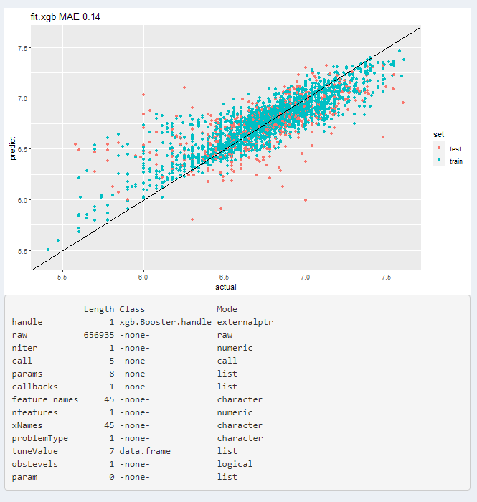
Prediction – Real Estate Price (continued)
The one with the best result (lowest MAE error) was the model trained with XGBoost.

Slide 5
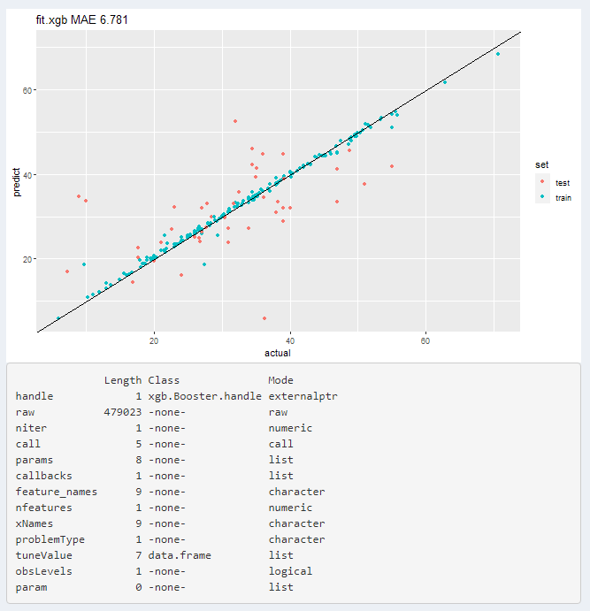
Prediction – Tunnel Boring Machine Utility
TBM (https://en.wikipedia.org/wiki/Tunnel_boring_machine) as it stands, is a type of construction machine used for boarding underground tunnels. We built a prediction model given (only a few) input variables of interest - boarding machine type, tunnel diameter, tunnel length in meter, and soil condition, predicting utility which is defined as the ratio of actual working days against total rental days.
Basically the same script used for rent prediction has been re-used in this case, with minor modification.
In this case, XGB also gives the best result. However, the presence of the

Slide 6
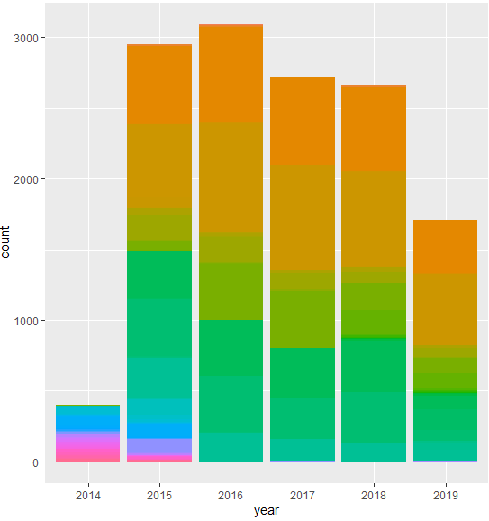
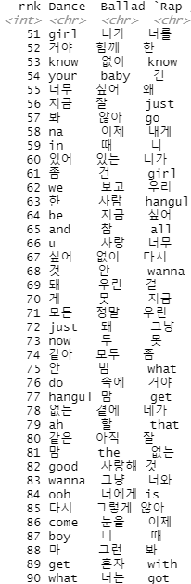
Kpop Lyric Text Analysis
Performed basic text analysis using Kpop lyrics (Korean and English translation) downloaded from https://klyrics.net/.
Did word frequency plot, investigated most frequently used words and trends in the lyrics by comparing word frequencies along the years.
I have downloaded articles from klyrics.net page, a total of 13,133 songs from 3,289 artists spanning to mid-2019.
Number of songs downloaded per year
Word frequency rank for three genres of Dance, Ballard and Rap. Definitely Dance and Rap songs have more English words than Ballard songs.

Slide 7
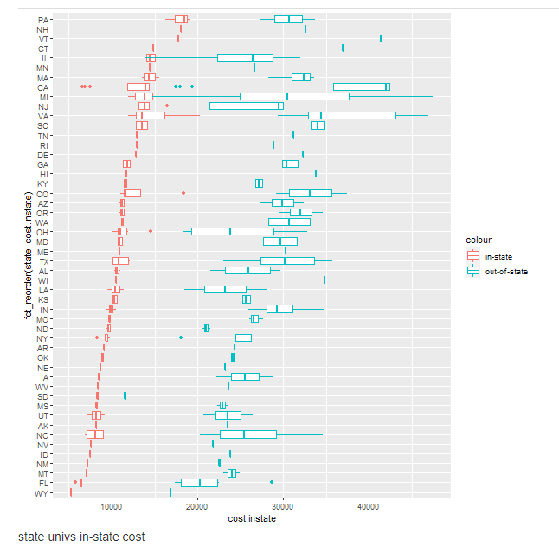
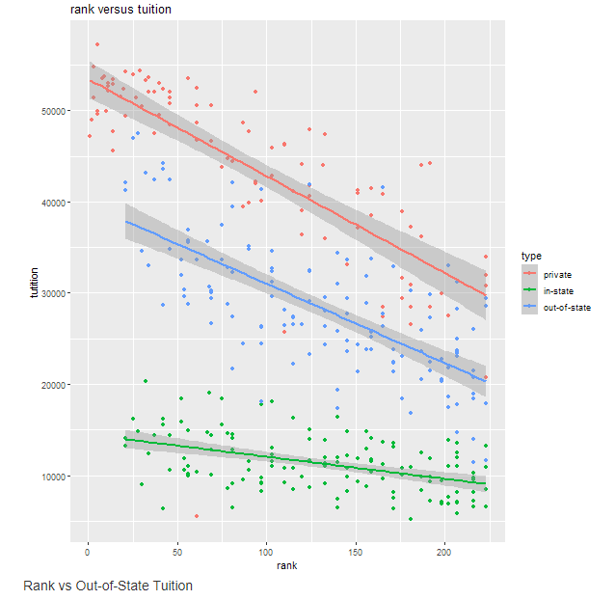
US News University Ranking Survey Data Mining
Collected college data from the "US News University Rankings" site by web scraping using R's httr package.
Post-process downloaded articles to extract information to create an R data file. Also created a shiny app to present reports showing various statistics such as tuition and rankings.
Tuition differences for in-state and out-of-state students
Rank versus tuition – pay $100 more for one rank up

Slide 8
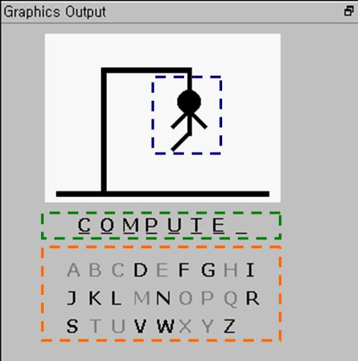
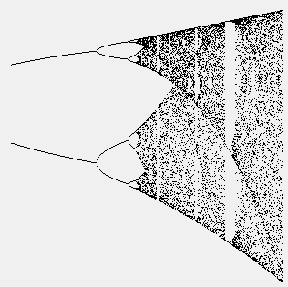

BASIC Programming Tutorial
Practiced computer programming using a dialect of BASIC language (BASIC256).
Learned fundamental programming skills such as variables, control structures, algorithms, and data structures. Built simple games, graphics, and simulations.
Drafted a tutorial, or a 80+page mini-book showing how to program BASIC.
Hangman Game
Logistic map showing Chaos
A virtual landscape using geometric objects

